Slide 1
Aspect-based Sentiment Classification with Graph Convolutional Networks
Hyunjae Kim
Data Mining & Information Systems Lab.
Department of Computer Science and Engineering,
College of Informatics, Korea University

Slide 2
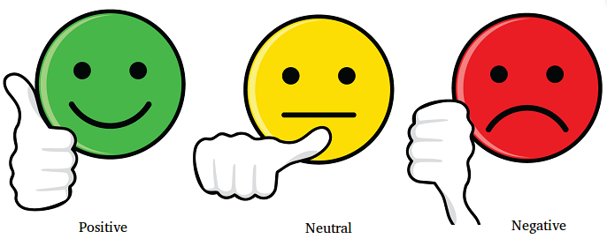
Sentiment Classification

Slide 3
Aspect-Based Sentiment Classification
Great food but the service was dreadful
Aspects : Food, Service
Sentiments :
Food → good, Service → bad

Slide 4
Limitations of Previous Models (1/2)
Attention-based models
Its size is ideal and the weight is acceptable.
Good food bad service

Slide 5
Limitations of Previous Models (1/2)
CNN-based models
The staff should be a bit more friendly.
The staff should be a bit more friendly.

Slide 6
Limitations of Previous Models (2/2)
The staff should be a bit more friendly
CNNs - the sentiment of an aspect is usually determined by key phrases instead of individual words.

Slide 7
Solution
Utilizing GCN!
Two papers accepted at EMNLP 2019
Aspect-based Sentiment Classification with Aspect-specific Graph Convolutional Networks
Syntax-Aware Aspect Level Sentiment Classification with Graph Attention Networks

Slide 8
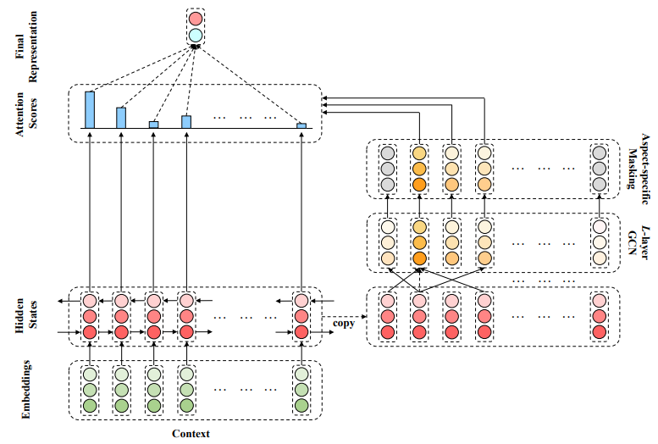
Approach 1 (1/3)

Slide 9
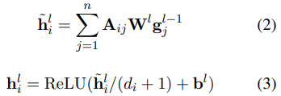

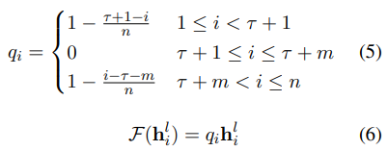
Approach 1 (2/3)
position weights

Slide 10
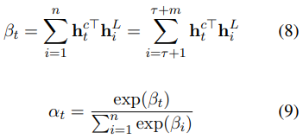


Approach 1 (3/3)
Aspect-specific Masking
Aspect-specific Attention

Slide 11
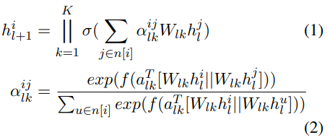


Approach 2

Slide 12
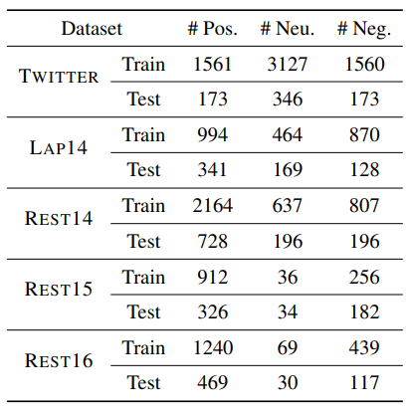
Datasets

Slide 13
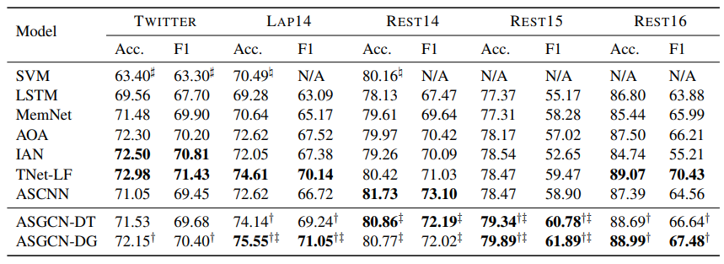
Results
a possible reason, supect, conjecture, ...

Slide 14
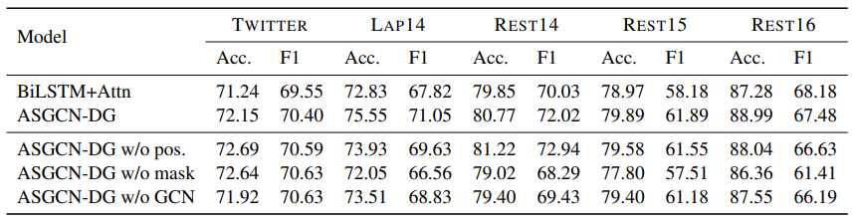
Ablation Study
Removal of pos → performance increases on Twitter and Rest14.
The GCN does not work well as expected on the datasets not sensitive to syntax information.

Slide 15
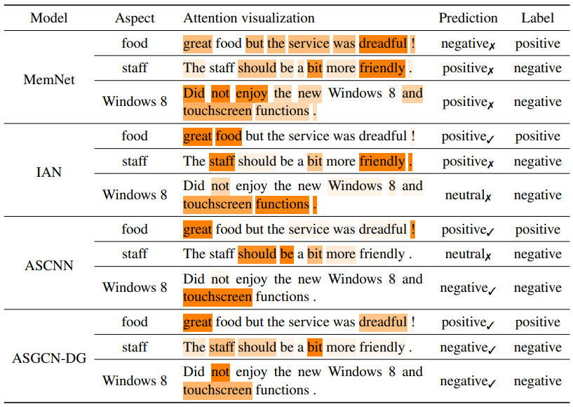
Case Study
0/3
1/3
2/3
3/3
long-range
multi-word

Slide 16
GGeut

